Slide 1
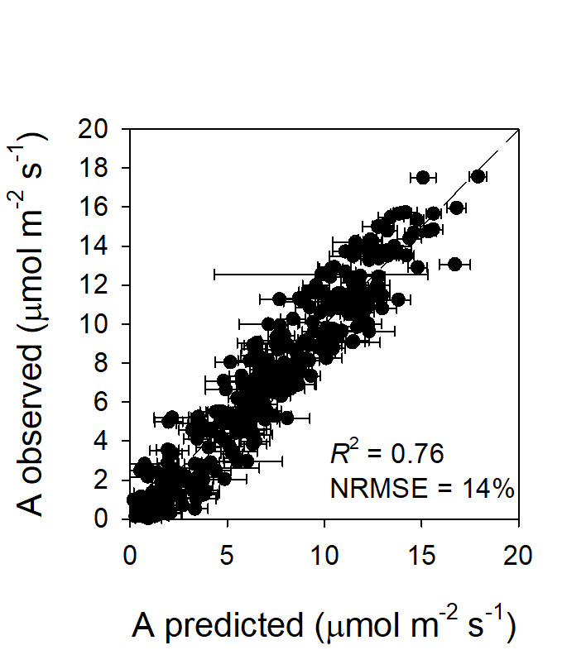
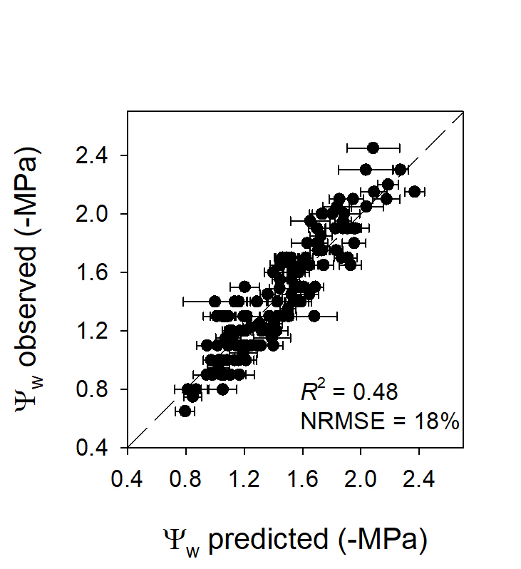

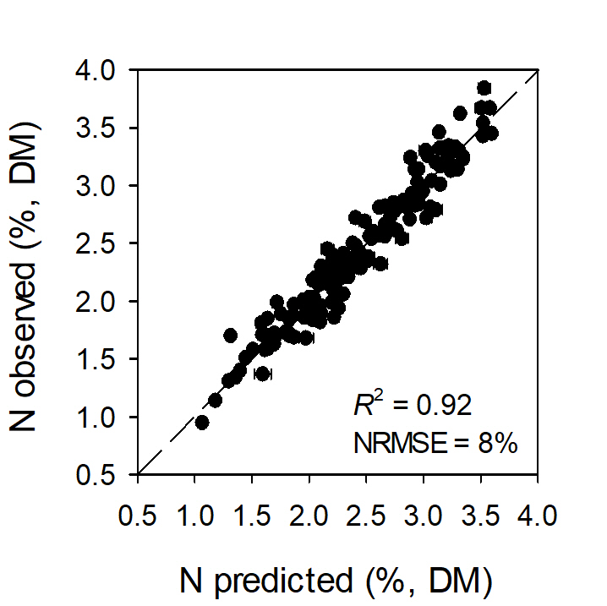
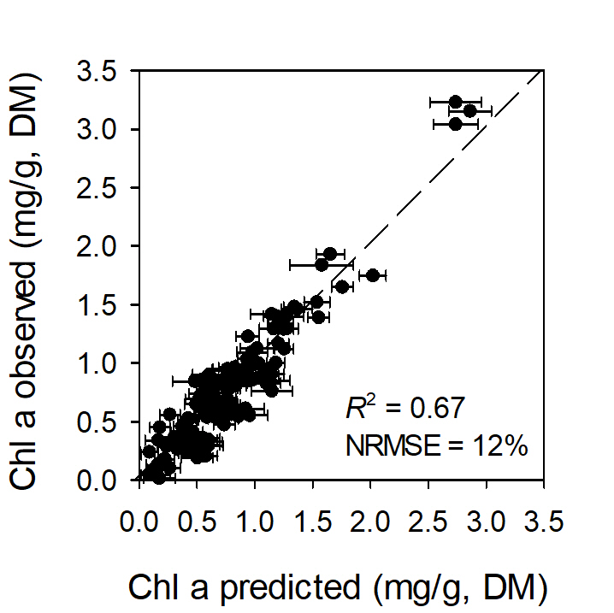
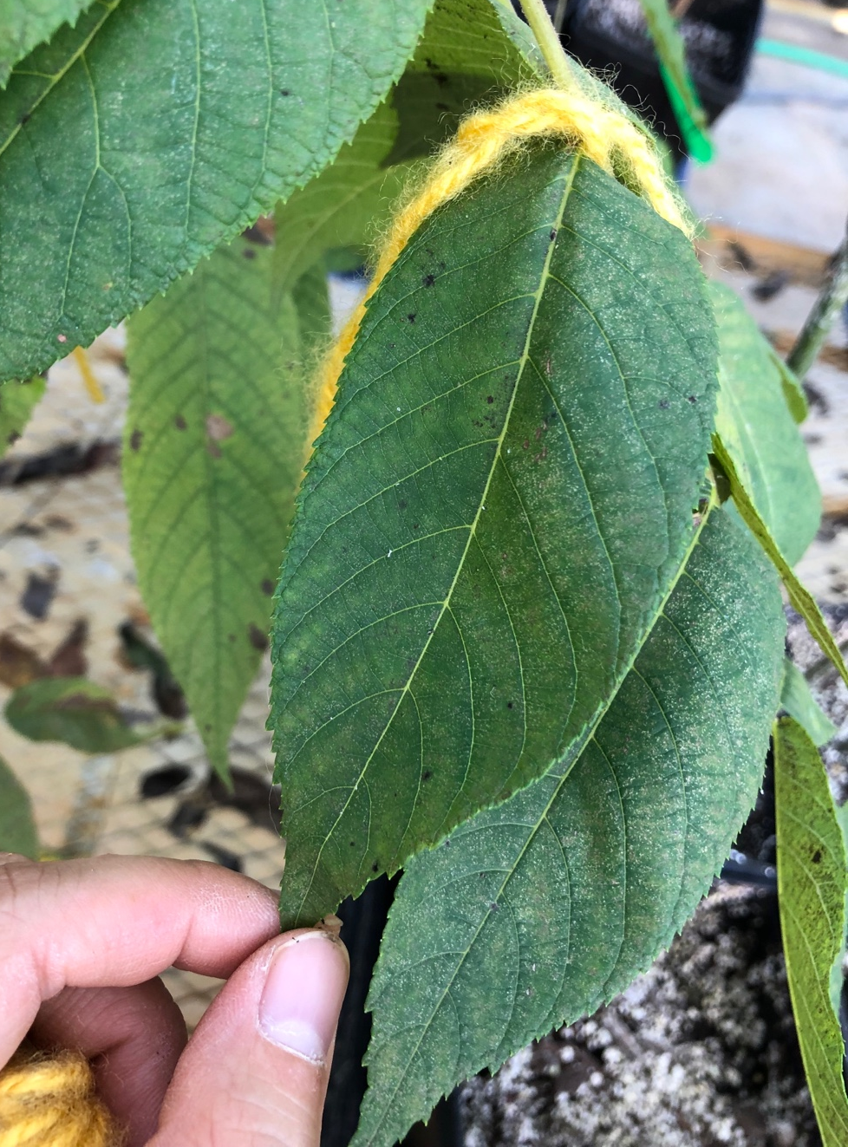
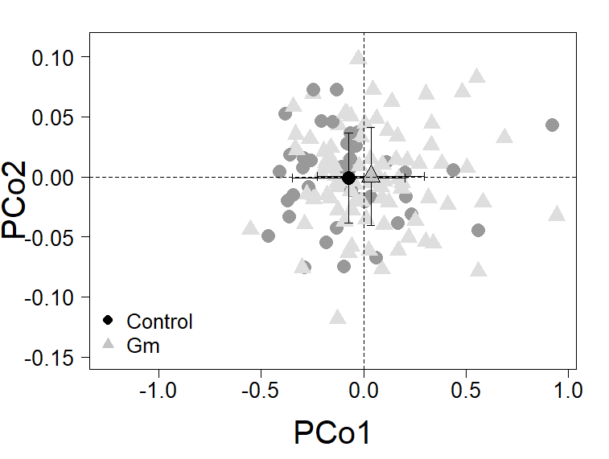
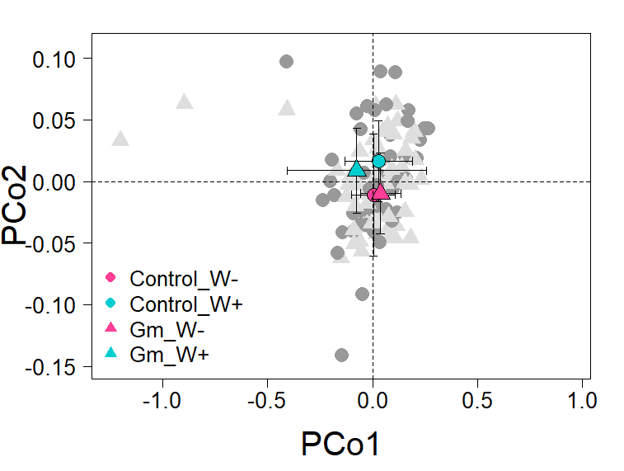
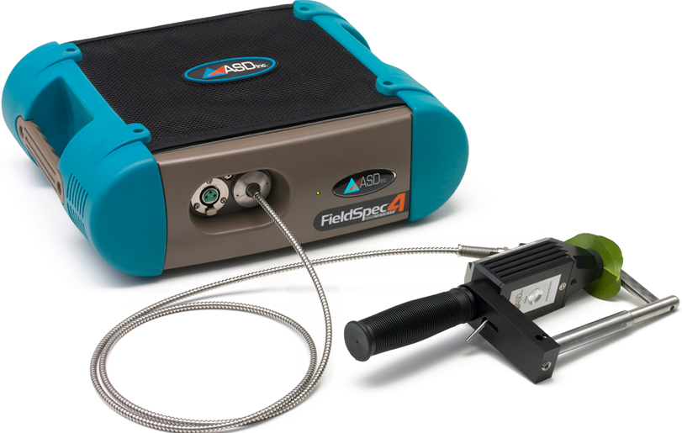


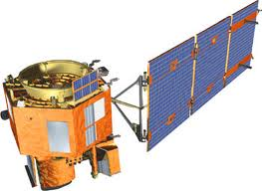
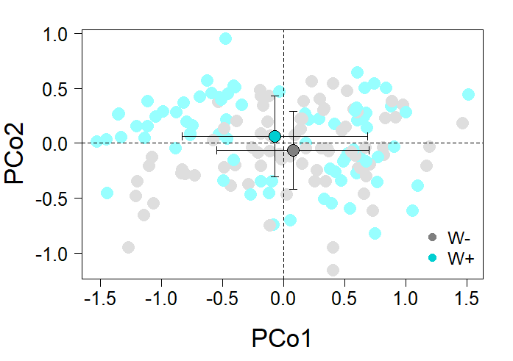
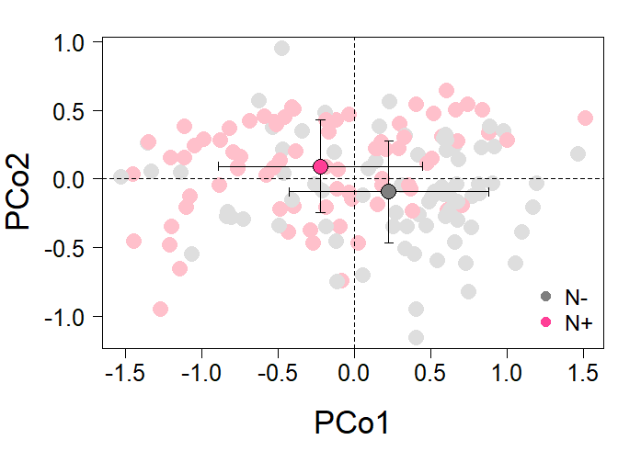

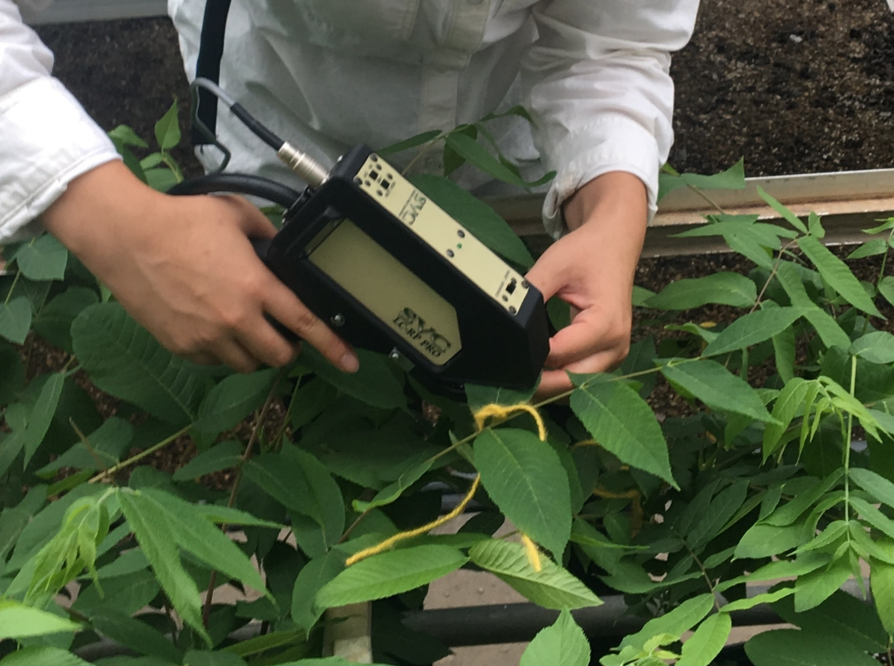


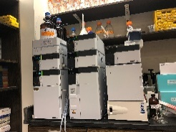





Hyperspectral analysis of tree foliar chemical and physiological responses to abiotic and biotic stress
KEY TAKEAWAYS
Results
Trait retrievals: Estimation of leaf functional traits
Hyperspectral data can identify biotic and abiotic stressors by detecting changes in leaf physiological and chemical properties non-destructively.
Predictive Models
Sylvia Park, Lorenzo Cotrozzi, Geoffrey Williams, Matthew Ginzel, Michael Mickelbart, Douglass Jacobs, John Couture
(a)
(b)
Background
Systematic monitoring of forest health is crucial to effective management of forest systems.
Traditional estimates of tree health status are time-consuming and logistically challenging to collect.
Hyperspectral data can increase the efficiency of monitoring and provide more detailed information of forest health at larger spatial scales than traditional measurements.
(c)
(d)
Objectives
Determine the ability of hyperspectral data to estimate plant functional traits in responses to different stress events, alone and in combination.
Determine the ability of hyperspectral data to classify different abiotic and biotic stress events.
Cost-effective, scalable advantages of this approach enable us to develop systematic forest health monitoring, and eventually help guide forest management decisions.
Materials and Methods
(a) A, CO₂ assimilation rate, (b) Ψ_{w}, water potential, (c) N, nitrogen concentration, (d) Chl a, chlorophyll a concentration. R² is external validation goodness-of-fit; NRMSE is normalized root mean squared error.
Over 18 functional traits estimated, R² ranged from 0.25 to 0.92 and NRMSE ranged from 8% to 22%.
Most leaf functional traits in response to stress treatments were reliably predicted by spectral data.
Black walnut and red oak seedlings were exposed to the different combination of abiotic and biotic stressors in a greenhouse.
Leaf spectral data were collected using Spectra Vista HR 1024i spectroradiometer (Spectra Vista Corporation, New York, USA).
Leaf chemical and physiological data were collected using standard analytical approaches.
Spectral phenotyping: Detection of stress
Four combinations of abiotic and biotic stressors
Fungal infection and drought
Fungal infection + Soil quality
Fungal infection + Drought
(a)
P < 0.05
(b)
P = 0.06
2018
2019
Nutrient deficiency + Drought
Nutrient deficiency
+ Salt deposition
Tree foliar stress responses
Drought and nutrient deficiency
Trait-based approach
Gas-exchange
Water content
Chemistry
Trait data collection
-Instrumental &
chemical analyses
Spectral data collection
-Spectroradiometer
(c)
P < 0.05
(d)
P < 0.001
Trait retrievals: We built predictive models to estimate leaf traits as a function of leaf spectra using partial least squares regression.
Spectral phenotyping: We used permutational multivariate analysis of variance and the principal coordinates analysis to see if the spectral data can classify stress treatment groups.
(a) Leaf spectral data identified the influence of fungal infection, Geosmithia morbida (G_{m}), in trees.
(b) Water stress had an influence on the ability of spectral profile to detect G_{m}.
(c, d) Leaf spectral data classified drought (c) and nutrient stress (d).
Notes:
48 inch width.
36 inch height.

